Slide 1
PYTHON ACTIVITY BASED LEARNING
Case Study Report
Name | N. Lakshya Sadhana
Section | Csm-4
Roll No. | 26001099
INTRODUCTION
This report presents ten Python Activity Based Learning case studies. Each case is organized with its problem statement, objectives, assumptions, algorithm, flowchart, pseudocode, Python program, test cases, output screenshot, and conclusion. The material is compiled from the files supplied in the Python Activity Based Learning folder.
CONTENTS — TEN CASE STUDIES
Case 01. Smart Parking Fee Management Case 02. Password Policy Validation Engine Case 03. Campus Transport Allocation
Case 04. Smart Canteen Order and Stock Management Case 05. Food Waste Monitoring System
Case 06. Sports Tournament Ranking System Case 07. University Admission Decision Engine Case 08. University Hostel Room Allocation
Case 09. Hackathon Team Formation and Ranking Case 10. University Scholarship Allocation
Note: Text and code are taken from the submitted folder. Where a conclusion was not present as a separate source file, a concise conclusion has been written to complete the requested report structure.

Slide 2
PYTHON ACTIVITY BASED LEARNING
CASE 01: Smart Parking Fee Management
Problem Statement
  Problem statement
Develop a Python program to calculate parking fees based on vehicle category, entry time, exit time, overnight parking, daily limits, and penalty charges. The program must validate time inputs and display the final parking bill.
  Objectives
Objectives
  Calculate parking duration and charges.
  Apply different rates for different vehicle categories.
  Handle overnight parking, daily limits, and penalties.
  Validate time inputs and display the final bill.
Assumptions
. Assumptions
These are sample rules for the program; they are not official parking rates. Vehicle | Rate per hour | Daily limit
Bike | ₹10 | ₹100 Car | ₹20 | ₹200 Bus | ₹40 | ₹400
  Any partial hour is charged as a full hour.
  Overnight parking adds ₹50.
  A penalty of ₹100 applies if the user reports a lost ticket.
  Entry and exit times use the 24-hour HH:MM format.
  The user specifies whether the exit is on the next day.
Algorithm
Algorithm
  Start.
  Enter vehicle category, entry time, exit time, and overnight status.
  Validate the vehicle category and time inputs.
  Calculate the total parking duration in minutes.
  Convert the duration into billable hours, rounding up partial hours.
  Calculate the parking charge using the vehicle's hourly rate.
  Apply the daily maximum limit.
  Add the overnight fee and any applicable lost-ticket penalty.
  Display the duration and final bill.
  Stop.

Slide 3
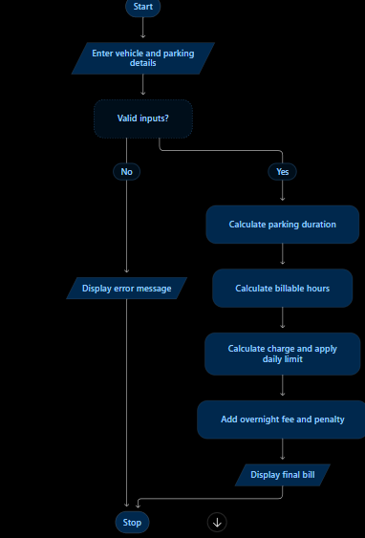
PYTHON ACTIVITY BASED LEARNING
5. Flowchart
6. Pseudocode
S T A R T
I N P U T v e h i c l e c a t e g o r y
I N P U T e n t r y t i m e a n d e x i t t i m e I N P U T n e x t - d a y e x i t s t a t u s I N P U T l o s t - t i c k e t s t a t u s
V A L I D A T E a l l i n p u t s I F i n p u t s a r e i n v a l i d
D I S P L A Y e r r o r m e s s a g e
E L S E
C A L C U L A T E p a r k i n g d u r a t i o n R O U N D p a r t i a l h o u r s u p w a r d C A L C U L A T E p a r k i n g c h a r g e A P P L Y d a i l y m a x i m u m l i m i t
I F o v e r n i g h t p a r k i n g A D D o v e r n i g h t f e e
E N D I F
I F t i c k e t i s l o s t A D D p e n a l t y
E N D I F
D I S P L A Y f i n a l b i l l E N D I F
S T O P

Slide 4
PYTHON ACTIVITY BASED LEARNING
7. Python Source Code / Program
# S m a r t P a r k i n g F e e M a n a g e m e n t
r a t e s = {
" b i k e " : 1 0 ,
" c a r " : 2 0 ,
" b u s " : 4 0
}
d a i l y _ l i m i t s = { " b i k e " : 1 0 0 ,
" c a r " : 2 0 0 ,
" b u s " : 4 0 0
}
d e f r e a d _ t i m e ( m e s s a g e ) : w h i l e T r u e :
v a l u e = i n p u t ( m e s s a g e ) . s t r i p ( ) p a r t s = v a l u e . s p l i t ( " : " )
i f l e n ( p a r t s ) = = 2 a n d a l l ( p . i s d i g i t ( ) f o r p i n p a r t s ) : h o u r = i n t ( p a r t s [ 0 ] )
m i n u t e = i n t ( p a r t s [ 1 ] )
i f 0 < = h o u r < = 2 3 a n d 0 < = m i n u t e < = 5 9 : r e t u r n h o u r * 6 0 + m i n u t e
p r i n t ( " I n v a l i d t i m e ! E n t e r t i m e a s H H : M M . " )
v e h i c l e = i n p u t ( " V e h i c l e ( b i k e / c a r / b u s ) : " ) . s t r i p ( ) . l o w e r ( ) i f v e h i c l e n o t i n r a t e s :
p r i n t ( " I n v a l i d v e h i c l e c a t e g o r y . " )
e l s e :
e n t r y = r e a d _ t i m e ( " E n t r y t i m e ( H H : M M ) : " ) e x i t _ t i m e = r e a d _ t i m e ( " E x i t t i m e ( H H : M M ) : " )
n e x t _ d a y = i n p u t ( " E x i t o n n e x t d a y ? ( y e s / n o ) : " ) . s t r i p ( ) . l o w e r ( ) l o s t = i n p u t ( " L o s t t i c k e t ? ( y e s / n o ) : " ) . s t r i p ( ) . l o w e r ( )
i f n e x t _ d a y n o t i n [ " y e s " , " n o " ] o r l o s t n o t i n [ " y e s " , " n o " ] : p r i n t ( " I n v a l i d y e s / n o i n p u t . " )
e l i f n e x t _ d a y = = " n o " a n d e x i t _ t i m e < = e n t r y : p r i n t ( " I n v a l i d p a r k i n g d u r a t i o n . " )
e l s e :
i f n e x t _ d a y = = " y e s " :
d u r a t i o n = ( 1 4 4 0 - e n t r y ) + e x i t _ t i m e e l s e :
d u r a t i o n = e x i t _ t i m e - e n t r y
h o u r s = ( d u r a t i o n + 5 9 ) / / 6 0 c h a r g e = h o u r s * r a t e s [ v e h i c l e ]
c h a r g e = m i n ( c h a r g e , d a i l y _ l i m i t s [ v e h i c l e ] )
o v e r n i g h t _ f e e = 5 0 i f n e x t _ d a y = = " y e s " e l s e 0 p e n a l t y = 1 0 0 i f l o s t = = " y e s " e l s e 0
t o t a l = c h a r g e + o v e r n i g h t _ f e e + p e n a l t y p r i n t ( " \ n - - - P A R K I N G B I L L - - - " )
p r i n t ( " V e h i c l e : " , v e h i c l e ) p r i n t ( " D u r a t i o n : " , d u r a t i o n / / 6 0 , " h o u r s " ,
d u r a t i o n % 6 0 , " m i n u t e s " ) p r i n t ( " P a r k i n g c h a r g e : R s . " , c h a r g e ) p r i n t ( " O v e r n i g h t f e e : R s . " , o v e r n i g h t _ f e e ) p r i n t ( " P e n a l t y : R s . " , p e n a l t y ) p r i n t ( " T o t a l a m o u n t : R s . " , t o t a l )

Slide 5
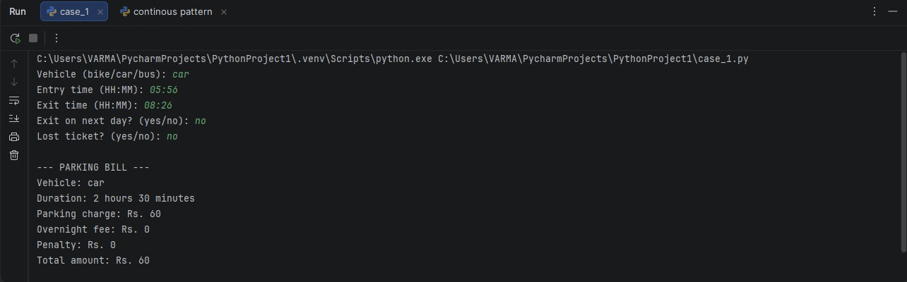
PYTHON ACTIVITY BASED LEARNING
8. Test Cases
Test cases
| Input details | Expected result
| Bike, 09:00–11:00, same day, no penalty | ₹20
| Car, 09:00–10:30, same day, no penalty | ₹40
| Bike, 09:00–22:00, same day, no penalty | ₹100 (daily limit)
| Car, 22:00–02:00, next day, no penalty | ₹130
| Bus, 09:00–10:00, same day, lost ticket | ₹140
| Invalid entry time, such as 25:70 | Ask for valid time again
Test
9. Output Screenshot
10. Conclusion
This program calculates parking fees using vehicle type, duration, daily limits, overnight fees, and ticket penalties. Input validation and a clear bill help make parking-charge calculations consistent.

Slide 6
PYTHON ACTIVITY BASED LEARNING
CASE 02: Password Policy Validation Engine
Problem Statement
Problem Statement
Passwords are used to protect user accounts and personal information. Weak passwords can make accounts vulnerable to unauthorized access. The Password Policy Validation Engine checks sample passwords against predefined rules, including minimum length, character categories, repeated characters, and prohibited substrings. It displays whether each password is valid and clearly explains any rules that it fails.
Objectives
Objectives
  To develop a Python program to validate passwords based on predefined security rules.
  To check the minimum password length of 8 characters.
  To verify the presence of uppercase letters, lowercase letters, digits, and special characters.
  To identify three or more identical consecutive characters in a password.
  To detect prohibited substrings such as "password".
  To display clear error messages explaining each failed condition.
  To determine whether a password is valid or invalid based on the defined rules.
Assumptions
Assumptions
  The minimum password length is 8 characters.
  A valid password must contain at least one uppercase letter (A–Z).
  A valid password must contain at least one lowercase letter (a–z).
  A valid password must contain at least one digit (0–9).
  A valid password must contain at least one special character, such as @, #, $, or !.
  Three or more identical consecutive characters are prohibited.
  The substring password is prohibited, regardless of letter case.
  A password is accepted only when all the rules are satisfied.
Algorithm
Algorithm
  Start the program.
  Define the password validation rules.
  Read a sample password from the user.
  Check whether the password has at least 8 characters.
  Check for uppercase letters, lowercase letters, digits, and special characters.
  Check whether any character repeats three or more times consecutively.
  Check whether the password contains the prohibited substring password, ignoring case.
  Store and display all failed conditions.
  If no rules fail, display “Password is Valid.” Otherwise, display “Password is Invalid.”
  Stop the program.

Slide 7
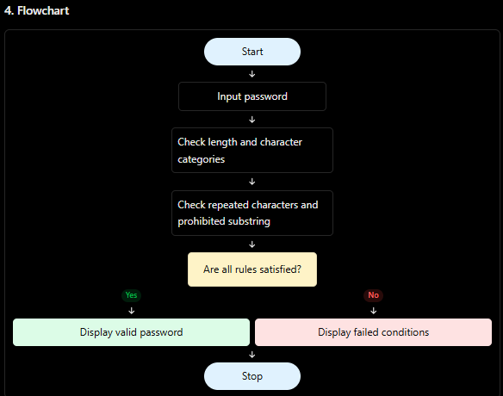
PYTHON ACTIVITY BASED LEARNING
5. Flowchart
6. Pseudocode
S T A R T
I N P U T p a s s w o r d
S E T e r r o r s = e m p t y l i s t
I F l e n g t h o f p a s s w o r d < 8
A D D " M i n i m u m l e n g t h n o t s a t i s f i e d " t o e r r o r s
I F n o u p p e r c a s e l e t t e r e x i s t s
A D D " U p p e r c a s e l e t t e r m i s s i n g " t o e r r o r s
I F n o l o w e r c a s e l e t t e r e x i s t s
A D D " L o w e r c a s e l e t t e r m i s s i n g " t o e r r o r s
I F n o d i g i t e x i s t s
A D D " D i g i t m i s s i n g " t o e r r o r s
I F n o s p e c i a l c h a r a c t e r e x i s t s
A D D " S p e c i a l c h a r a c t e r m i s s i n g " t o e r r o r s
I F t h r e e o r m o r e i d e n t i c a l c o n s e c u t i v e c h a r a c t e r s e x i s t A D D " R e p e a t e d c h a r a c t e r s n o t a l l o w e d " t o e r r o r s
I F " p a s s w o r d " o c c u r s i n p a s s w o r d i g n o r i n g c a s e A D D " P r o h i b i t e d s u b s t r i n g f o u n d " t o e r r o r s
I F e r r o r s i s e m p t y
D I S P L A Y " P a s s w o r d i s V a l i d "
E L S E
D I S P L A Y " P a s s w o r d i s I n v a l i d " D I S P L A Y a l l e r r o r s
S T O P

Slide 8
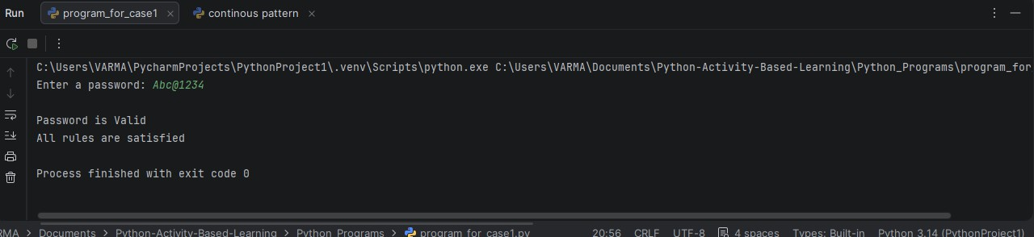
PYTHON ACTIVITY BASED LEARNING
Python Source Code / Program
p a s s w o r d = i n p u t ( " E n t e r a p a s s w o r d : " ) e r r o r s = [ ]
i f l e n ( p a s s w o r d ) < 8 :
e r r o r s . a p p e n d ( " P a s s w o r d m u s t c o n t a i n a t l e a s t 8 c h a r a c t e r s " ) i f n o t a n y ( c h . i s u p p e r ( ) f o r c h i n p a s s w o r d ) :
e r r o r s . a p p e n d ( " A t l e a s t o n e u p p e r c a s e l e t t e r i s r e q u i r e d " ) i f n o t a n y ( c h . i s l o w e r ( ) f o r c h i n p a s s w o r d ) :
e r r o r s . a p p e n d ( " A t l e a s t o n e l o w e r c a s e l e t t e r i s r e q u i r e d " ) i f n o t a n y ( c h . i s d i g i t ( ) f o r c h i n p a s s w o r d ) :
e r r o r s . a p p e n d ( " A t l e a s t o n e d i g i t i s r e q u i r e d " ) s p e c i a l = " @ # $ ! % & * ? "
i f n o t a n y ( c h i n s p e c i a l f o r c h i n p a s s w o r d ) : e r r o r s . a p p e n d ( " A t l e a s t o n e s p e c i a l c h a r a c t e r i s r e q u i r e d " )
f o r i i n r a n g e ( l e n ( p a s s w o r d ) - 2 ) :
i f p a s s w o r d [ i ] = = p a s s w o r d [ i + 1 ] = = p a s s w o r d [ i + 2 ] :
e r r o r s . a p p e n d ( " T h r e e c o n s e c u t i v e i d e n t i c a l c h a r a c t e r s a r e n o t a l l o w e d " ) b r e a k
i f " p a s s w o r d " i n p a s s w o r d . l o w e r ( ) :
e r r o r s . a p p e n d ( " T h e w o r d ' p a s s w o r d ' i s n o t a l l o w e d " ) i f l e n ( e r r o r s ) = = 0 :
p r i n t ( " \ n P a s s w o r d i s V a l i d " ) p r i n t ( " A l l r u l e s a r e s a t i s f i e d " )
e l s e :
p r i n t ( " \ n P a s s w o r d i s I n v a l i d " ) p r i n t ( " R e a s o n s : " )
f o r e r r o r i n e r r o r s : p r i n t ( " - " , e r r o r )
Test Cases
Test Cases
Test case | Input password | Expected result
TC01 TC02 TC03 TC04 TC05 TC06 TC07 TC08 TC09 TC10
| Abc@1234 | Valid
| abc | Invalid — length and category rules fail
| abcdefgh1@ | Invalid — uppercase missing
| ABCDEFG1@ | Invalid — lowercase missing
| Abcdefgh@ | Invalid — digit missing
| Abcdefg12 | Invalid — special character missing
| Abc@1111 | Invalid — repeated consecutive characters
| Password@1 | Invalid — prohibited substring
| Xy@98765 | Valid
| Aa@12345 | Valid
9. Output Screenshot
10. Conclusion
This program checks a sample password against the defined security rules and reports the conditions that fail. It demonstrates how several independent checks can be combined to support safer password selection.

Slide 9
PYTHON ACTIVITY BASED LEARNING
CASE 03: Campus Transport Allocation
Problem Statement
Problem Statement
Campus transport management requires allocating a sufficient number of buses to different routes based on passenger demand and bus capacity. If the number of buses is insufficient, some passengers may not get seats. This project develops a Python program to calculate the number of buses required for each route, determine the total buses needed, and identify the number of unserved passengers when only a limited number of buses are available.
Objectives
Objectives
  To develop a Python program for campus bus allocation.
  To calculate the number of buses required for each route based on passenger demand.
  To consider the seating capacity of each bus.
  To calculate the total number of buses required for all routes.
  To identify the number of passengers who cannot be accommodated.
  To display the allocation results clearly for efficient transport planning.
Assumptions
Assumptions
  Each bus has a fixed seating capacity.
  Passenger demand is known for every route.
  All buses have the same seating capacity.
  Each bus can operate on only one route for the allocation being calculated.
  A bus cannot carry more passengers than its seating capacity.
  The number of buses required for a route is rounded up to the next whole number.
  If the available buses are insufficient, passengers exceeding the available capacity are considered unserved.
  Passenger demand and bus capacity must be non-negative, and bus capacity must be greater than zero.
Algorithm
Algorithm
  Start the program.
  Input the number of routes, bus seating capacity, and total available buses.
  Input the passenger demand for each route.
  Calculate the buses required for each route using:
  Calculate the total number of buses required for all routes.
  Allocate available buses to routes in the order entered by the user.
  Calculate the number of passengers who can be served on each route.
  Calculate unserved passengers by subtracting served passengers from total demand.
  Display the buses required, buses allocated, served passengers, and unserved passengers for each route.
  Display the total buses required and total unserved passengers.
  Stop the program.

Slide 10
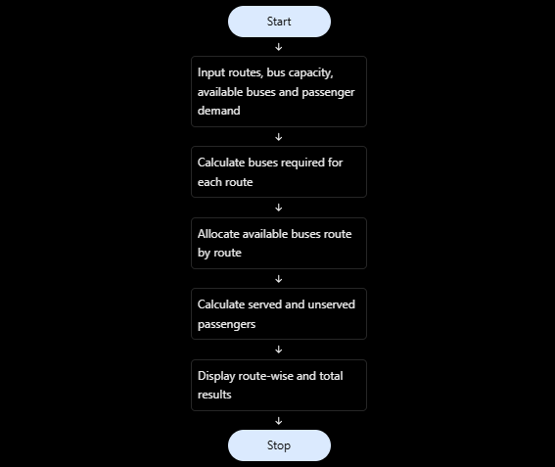
PYTHON ACTIVITY BASED LEARNING
5. Flowchart
6. Pseudocode
S T A R T
I N P U T n u m b e r _ o f _ r o u t e s I N P U T b u s _ c a p a c i t y I N P U T a v a i l a b l e _ b u s e s
S E T t o t a l _ r e q u i r e d = 0 S E T t o t a l _ u n s e r v e d = 0
S E T r e m a i n i n g _ b u s e s = a v a i l a b l e _ b u s e s
F O R e a c h r o u t e :
I N P U T p a s s e n g e r _ d e m a n d
r e q u i r e d _ b u s e s = ( p a s s e n g e r _ d e m a n d + b u s _ c a p a c i t y - 1 )
/ / b u s _ c a p a c i t y
t o t a l _ r e q u i r e d = t o t a l _ r e q u i r e d + r e q u i r e d _ b u s e s a l l o c a t e d _ b u s e s = M I N ( r e q u i r e d _ b u s e s , r e m a i n i n g _ b u s e s ) r e m a i n i n g _ b u s e s = r e m a i n i n g _ b u s e s - a l l o c a t e d _ b u s e s s e r v e d _ p a s s e n g e r s = M I N ( p a s s e n g e r _ d e m a n d ,
a l l o c a t e d _ b u s e s * b u s _ c a p a c i t y )
u n s e r v e d _ p a s s e n g e r s = p a s s e n g e r _ d e m a n d - s e r v e d _ p a s s e n g e r s t o t a l _ u n s e r v e d = t o t a l _ u n s e r v e d + u n s e r v e d _ p a s s e n g e r s D I S P L A Y r o u t e d e t a i l s
D I S P L A Y t o t a l _ r e q u i r e d D I S P L A Y t o t a l _ u n s e r v e d
S T O P

Slide 11
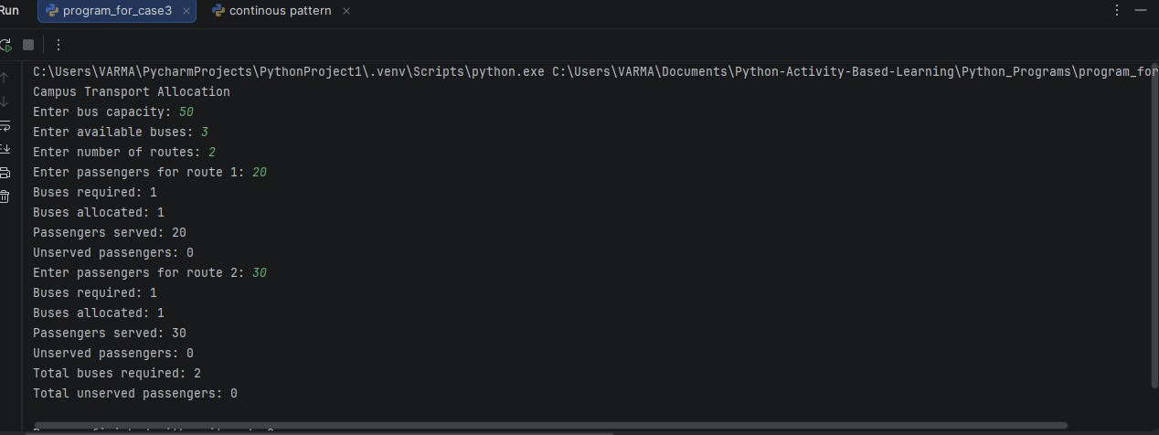
PYTHON ACTIVITY BASED LEARNING
Python Source Code / Program
p r i n t ( " C a m p u s T r a n s p o r t A l l o c a t i o n " ) c a p a c i t y = i n t ( i n p u t ( " E n t e r b u s c a p a c i t y : " ) ) b u s e s = i n t ( i n p u t ( " E n t e r a v a i l a b l e b u s e s : " ) )
r o u t e s = i n t ( i n p u t ( " E n t e r n u m b e r o f r o u t e s : " ) ) t o t a l _ r e q u i r e d = 0
t o t a l _ u n s e r v e d = 0
f o r i i n r a n g e ( 1 , r o u t e s + 1 ) :
p a s s e n g e r s = i n t ( i n p u t ( " E n t e r p a s s e n g e r s f o r r o u t e " + s t r ( i ) + " : " ) ) r e q u i r e d = ( p a s s e n g e r s + c a p a c i t y - 1 ) / / c a p a c i t y
t o t a l _ r e q u i r e d + = r e q u i r e d i f b u s e s > = r e q u i r e d :
a l l o c a t e d = r e q u i r e d e l s e :
a l l o c a t e d = b u s e s
b u s e s = b u s e s - a l l o c a t e d s e r v e d = a l l o c a t e d * c a p a c i t y i f s e r v e d > p a s s e n g e r s :
s e r v e d = p a s s e n g e r s
u n s e r v e d = p a s s e n g e r s - s e r v e d t o t a l _ u n s e r v e d + = u n s e r v e d
p r i n t ( " B u s e s r e q u i r e d : " , r e q u i r e d ) p r i n t ( " B u s e s a l l o c a t e d : " , a l l o c a t e d ) p r i n t ( " P a s s e n g e r s s e r v e d : " , s e r v e d ) p r i n t ( " U n s e r v e d p a s s e n g e r s : " , u n s e r v e d )
p r i n t ( " T o t a l b u s e s r e q u i r e d : " , t o t a l _ r e q u i r e d ) p r i n t ( " T o t a l u n s e r v e d p a s s e n g e r s : " , t o t a l _ u n s e r v e d )
Test Cases
Test Cases
Test case | Bus capacity | Available buses | Route demands
| Expected result
TC01 TC02 TC03 TC04 TC05 TC06
| 40 | 6 | 70, 60, 50
| 40 | 5 | 70, 60, 50
| 50 | 4 | 20, 30, 40
| 30 | 2 | 50, 40
| 40 | 0 | 20, 30
| 40 | 3 | 0, 0, 0
| 6 buses required; 0 unserved
| 6 required; 10 unserved
| 3 required; 0 unserved
| 4 required; 30 unserved
| 2 required; 50 unserved
| 0 buses required; 0 unserved
9. Output Screenshot
10. Conclusion
This program estimates the buses needed for each campus route from passenger demand and seating capacity. It also identifies unserved passengers when the available fleet is insufficient.

Slide 12
PYTHON ACTIVITY BASED LEARNING
CASE 04: Smart Canteen Order and Stock Management
Problem Statement
Problem Statement
A canteen needs a simple system to process customer orders, calculate bills, update available stock, and track daily sales. Manually managing orders and inventory can lead to billing errors and stock shortages. This project develops a Python program that accepts successive customer orders, checks product availability, rejects orders that exceed available stock, calculates bills, updates inventory after successful orders, and displays total daily sales and remaining stock.
Objectives
Objectives
  To develop a Python program for canteen order and stock management.
  To process multiple customer orders successively.
  To calculate the bill based on item prices and quantities.
  To check stock availability before confirming an order.
  To reject orders when the requested quantity exceeds available stock.
  To update inventory after each successful order.
  To calculate total daily sales and display the remaining stock.
Assumptions
Assumptions
  The canteen sells a fixed list of food items.
  Each item has a fixed price and an initial stock quantity.
  Customers select items using their names.
  The requested quantity must be a positive whole number.
  An order is accepted only if the requested quantity is available.
  Stock is reduced only when an order is accepted.
  Rejected orders do not contribute to daily sales.
  The program ends when the user enters done instead of an item name.
Algorithm
Algorithm
  Start the program.
  Initialize the food items, prices, and available stock.
  Set total daily sales to zero.
  Ask the customer to enter a food item name.
  If the customer enters done, stop accepting orders.
  Check whether the item exists in the menu.
  If the item exists, ask for the required quantity.
  Check whether the quantity is valid and sufficient stock is available.
  If stock is insufficient, reject the order without changing the stock.
  Otherwise, calculate the bill and update the remaining stock.
  Add the bill amount to total daily sales.
  Repeat the process for the next order.
  Display total daily sales and remaining stock for all items.
  Stop the program.

Slide 13
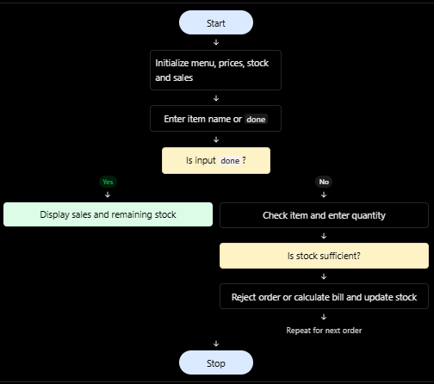
PYTHON ACTIVITY BASED LEARNING
5. Flowchart
6. Pseudocode
S T A R T
I N I T I A L I Z E m e n u w i t h i t e m p r i c e s I N I T I A L I Z E s t o c k q u a n t i t i e s
S E T t o t a l _ s a l e s = 0
R E P E A T
I N P U T i t e m _ n a m e
I F i t e m _ n a m e = " d o n e " E X I T L O O P
I F i t e m _ n a m e d o e s n o t e x i s t D I S P L A Y " I t e m n o t a v a i l a b l e " C O N T I N U E
I N P U T q u a n t i t y I F q u a n t i t y < = 0
D I S P L A Y " I n v a l i d q u a n t i t y " C O N T I N U E
I F q u a n t i t y > a v a i l a b l e s t o c k D I S P L A Y " I n s u f f i c i e n t s t o c k "
E L S E
b i l l = p r i c e × q u a n t i t y s t o c k = s t o c k - q u a n t i t y
t o t a l _ s a l e s = t o t a l _ s a l e s + b i l l D I S P L A Y b i l l
U N T I L u s e r e n t e r s " d o n e " D I S P L A Y t o t a l _ s a l e s
D I S P L A Y r e m a i n i n g s t o c k o f a l l i t e m s
S T O P

Slide 14
PYTHON ACTIVITY BASED LEARNING
Python Source Code / Program
p r i n t ( " S m a r t C a n t e e n M a n a g e m e n t " )
i d l i = 2 0
d o s a = 1 5
t e a = 3 0
s a l e s = 0 w h i l e T r u e :
p r i n t ( " \ n 1 . I d l i - R s . 2 0 ( S t o c k : " , i d l i , " ) " )
p r i n t ( " 2 . D o s a - R s . 4 0 ( S t o c k : " , d o s a , " ) " )
p r i n t ( " 3 . T e a - R s . 1 0 ( S t o c k : " , t e a , " ) " ) p r i n t ( " 0 . F i n i s h o r d e r s " )
c h o i c e = i n t ( i n p u t ( " E n t e r y o u r c h o i c e : " ) ) i f c h o i c e = = 0 :
b r e a k
q u a n t i t y = i n t ( i n p u t ( " E n t e r q u a n t i t y : " ) ) i f q u a n t i t y < = 0 :
p r i n t ( " I n v a l i d q u a n t i t y ! " )
e l i f c h o i c e = = 1 :
i f q u a n t i t y < = i d l i : b i l l = q u a n t i t y * 2 0 i d l i - = q u a n t i t y s a l e s + = b i l l
p r i n t ( " B i l l : R s . " , b i l l ) e l s e :
p r i n t ( " I n s u f f i c i e n t i d l i s t o c k ! " )
e l i f c h o i c e = = 2 :
i f q u a n t i t y < = d o s a : b i l l = q u a n t i t y * 4 0 d o s a - = q u a n t i t y s a l e s + = b i l l
p r i n t ( " B i l l : R s . " , b i l l ) e l s e :
p r i n t ( " I n s u f f i c i e n t d o s a s t o c k ! " )
e l i f c h o i c e = = 3 :
i f q u a n t i t y < = t e a : b i l l = q u a n t i t y * 1 0 t e a - = q u a n t i t y s a l e s + = b i l l
p r i n t ( " B i l l : R s . " , b i l l ) e l s e :
p r i n t ( " I n s u f f i c i e n t t e a s t o c k ! " )
e l s e :
p r i n t ( " I n v a l i d c h o i c e ! " )
p r i n t ( " \ n - - - D a i l y R e p o r t - - - " ) p r i n t ( " T o t a l S a l e s : R s . " , s a l e s ) p r i n t ( " R e m a i n i n g I d l i : " , i d l i ) p r i n t ( " R e m a i n i n g D o s a : " , d o s a ) p r i n t ( " R e m a i n i n g T e a : " , t e a )
Test Cases
Test Cases
Test case | Input / condition | Expected result
TC01 TC02 TC03 TC04 TC05 TC06 TC07
| Order 2 idlis | Bill ₹40; stock decreases by 2
| Order 3 dosas | Bill ₹120; stock decreases by 3
| Order 50 teas | Rejected because stock is insufficient
| Enter an unknown item, pizza | Item not available
| Enter quantity 0 | Invalid quantity
| Place multiple successful orders | Daily sales show the sum of accepted bills
| Enter done | Daily report and remaining stock are displayed

Slide 15
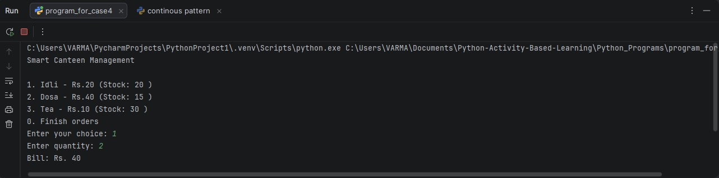
PYTHON ACTIVITY BASED LEARNING
9. Output Screenshot
10. Conclusion
This program processes canteen orders, checks stock before accepting each order, updates inventory, calculates bills, and tracks daily sales. It helps reduce manual billing mistakes and stock-management confusion.

Slide 16
PYTHON ACTIVITY BASED LEARNING
CASE 05: Food Waste Monitoring System
Problem Statement
Problem Statement
Food waste is a common problem in schools, colleges, hostels, and canteens. Preparing more food than needed leads to unnecessary waste and increased costs. The Food Waste Monitoring System compares the number of meals prepared, meals served, and leftover meals over several days. It calculates the food wastage percentage and identifies days when wastage exceeds an acceptable limit.
Objectives
Objectives
  To develop a Python program to monitor food waste over several days.
  To record the number of meals prepared and meals served each day.
  To calculate the number of leftover meals.
  To calculate the daily food wastage percentage.
  To identify days when food wastage exceeds the acceptable limit.
  To help improve food preparation and reduce unnecessary waste.
Assumptions
Assumptions
  The system records data for multiple days.
  The number of meals prepared and served is a non-negative whole number.
  Meals served cannot exceed meals prepared.
  Leftover meals are calculated as meals prepared minus meals served.
  The acceptable food wastage limit is assumed to be 10%.
  Wastage percentage is calculated using the number of meals prepared.
  If wastage exceeds 10%, the day is marked as exceeding the acceptable limit.
Algorithm
Algorithm
  Start the program.
  Set the acceptable wastage limit to 10%.
  Enter the number of days to monitor.
  For each day, input the number of meals prepared and meals served.
  Calculate leftover meals by subtracting meals served from meals prepared.
  Calculate the wastage percentage using the formula:
  Compare the wastage percentage with the acceptable limit.
  If wastage exceeds 10%, display a warning for that day.
  Otherwise, display that wastage is within the acceptable limit.
  Repeat for all days.
  Display the results for each day.
  Stop the program.

Slide 17
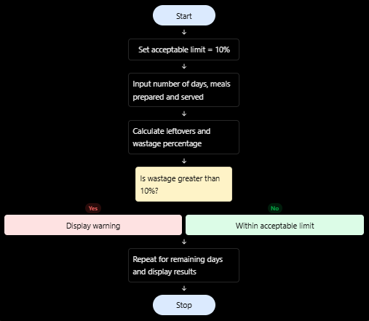
PYTHON ACTIVITY BASED LEARNING
5. Flowchart
6. Pseudocode
S T A R T
S E T l i m i t = 1 0 I N P U T n u m b e r _ o f _ d a y s F O R e a c h d a y :
I N P U T m e a l s _ p r e p a r e d I N P U T m e a l s _ s e r v e d
l e f t o v e r s = m e a l s _ p r e p a r e d - m e a l s _ s e r v e d I F m e a l s _ p r e p a r e d > 0 :
w a s t a g e = ( l e f t o v e r s / m e a l s _ p r e p a r e d ) * 1 0 0 E L S E :
w a s t a g e = 0
D I S P L A Y l e f t o v e r s
D I S P L A Y w a s t a g e p e r c e n t a g e
I F w a s t a g e > l i m i t :
D I S P L A Y " W a s t a g e e x c e e d s a c c e p t a b l e l i m i t " E L S E :
D I S P L A Y " W a s t a g e i s w i t h i n a c c e p t a b l e l i m i t "
S T O P

Slide 18
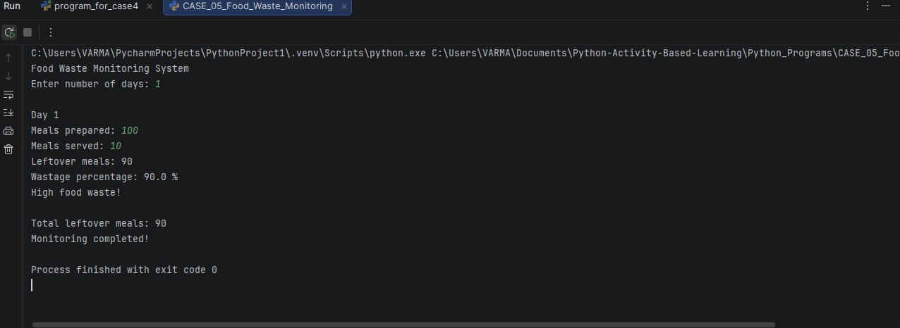
PYTHON ACTIVITY BASED LEARNING
7. Python Source Code / Program
p r i n t ( " F o o d W a s t e M o n i t o r i n g S y s t e m " )
d a y s = i n t ( i n p u t ( " E n t e r n u m b e r o f d a y s : " ) ) t o t a l _ w a s t e = 0
f o r i i n r a n g e ( 1 , d a y s + 1 ) : p r i n t ( " \ n D a y " , i )
p r e p a r e d = i n t ( i n p u t ( " M e a l s p r e p a r e d : " ) ) s e r v e d = i n t ( i n p u t ( " M e a l s s e r v e d : " ) ) l e f t o v e r = p r e p a r e d - s e r v e d
t o t a l _ w a s t e + = l e f t o v e r i f p r e p a r e d > 0 :
p e r c e n t a g e = l e f t o v e r / p r e p a r e d * 1 0 0 e l s e :
p e r c e n t a g e = 0
p r i n t ( " L e f t o v e r m e a l s : " , l e f t o v e r )
p r i n t ( " W a s t a g e p e r c e n t a g e : " , r o u n d ( p e r c e n t a g e , 2 ) , " % " )
i f p e r c e n t a g e > 1 0 : p r i n t ( " H i g h f o o d w a s t e ! " )
e l s e :
p r i n t ( " F o o d w a s t e i s a c c e p t a b l e . " )
p r i n t ( " \ n T o t a l l e f t o v e r m e a l s : " , t o t a l _ w a s t e ) p r i n t ( " M o n i t o r i n g c o m p l e t e d ! " )
8. Test Cases
Test Cases
Test case | Meals prepared | Meals served | Leftovers
TC01 TC02 TC03 TC04 TC05 TC06
| 100 | 95 | 5 | 5% | Within limit
| 100 | 80 | 20 | 20% | Exceeds limit
| 200 |
|
|
|
| Wastage | Expected result
50 | 40 |
100 | 100
0 | 0 | 0
180 | 20 | 10%
10 | 20% |
| 0 | 0% |
| Within limit Exceeds limit Within limit
| 0% | Within limit
9. Output Screenshot
10. Conclusion
This program calculates leftovers and wastage percentages for each monitored day. Comparing the result with the chosen 10% limit helps identify days that may need improved meal planning.

Slide 19
PYTHON ACTIVITY BASED LEARNING
CASE 06: Sports Tournament Ranking System
Problem Statement
Problem Statement
In sports tournaments, teams must be ranked based on their match results and scores. Calculating rankings manually can lead to errors, especially when teams have equal points. This project develops a Python program to record team results, calculate total points and tie-break values, and display the final rankings according to a predefined competition policy.
Objectives
Objectives
  To develop a Python program for ranking teams in a sports tournament.
  To store team names and match results.
  To calculate total points earned by each team.
  To calculate tie-break values using scores.
  To rank teams according to the competition rules.
  To display the final tournament standings.
Assumptions
Assumptions
  Each team plays a fixed number of matches.
  A win earns 3 points, a draw earns 1 point, and a loss earns 0 points.
  Each match records the scores of both teams.
  The tie-break value is calculated as total scores scored minus total scores conceded.
  Teams are ranked by total points first, then by tie-break value.
  If both values are equal, the teams share the same ranking position.
  Match scores cannot be negative.
Algorithm
Algorithm
  Start the program.
  Input the number of teams.
  Enter each team's name and initialize its points and scores to zero.
  Input the number of matches.
  For each match, enter the two team names and their scores.
  Award 3 points to the winner or 1 point to each team in a draw.
  Update each team's total score and scores conceded.
  Calculate the tie-break value as scores scored minus scores conceded.
  Sort teams by total points in descending order, followed by tie-break value in descending order.
  Display the final rankings, points, and tie-break values.
  Stop the program.

Slide 20
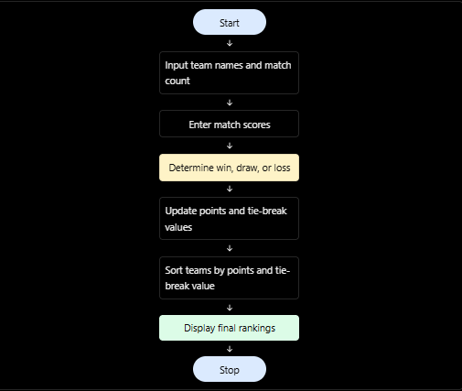
PYTHON ACTIVITY BASED LEARNING
5. Flowchart
Pseudocode
S T A R T
I N P U T t e a m n a m e s
I N I T I A L I Z E p o i n t s a n d s c o r e s t o z e r o
I N P U T n u m b e r o f m a t c h e s F O R e a c h m a t c h :
I N P U T t e a m 1 , t e a m 2 I N P U T s c o r e 1 , s c o r e 2
U P D A T E s c o r e s s c o r e d a n d c o n c e d e d I F s c o r e 1 > s c o r e 2 :
t e a m 1 g e t s 3 p o i n t s E L S E I F s c o r e 2 > s c o r e 1 :
t e a m 2 g e t s 3 p o i n t s E L S E :
b o t h t e a m s g e t 1 p o i n t
C A L C U L A T E t i e - b r e a k v a l u e f o r e a c h t e a m S O R T t e a m s b y :
  T o t a l p o i n t s ( d e s c e n d i n g )
  T i e - b r e a k v a l u e ( d e s c e n d i n g )
D I S P L A Y t e a m r a n k i n g s a n d p o i n t s S T O P

Slide 21
PYTHON ACTIVITY BASED LEARNING
Python Source Code / Program
p r i n t ( " S p o r t s T o u r n a m e n t R a n k i n g S y s t e m " )
t e a m s = [ ] p o i n t s = [ ] s c o r e s = [ ]
n = i n t ( i n p u t ( " E n t e r n u m b e r o f t e a m s : " ) ) f o r i i n r a n g e ( n ) :
n a m e = i n p u t ( " E n t e r t e a m n a m e : " ) t e a m s . a p p e n d ( n a m e ) p o i n t s . a p p e n d ( 0 ) s c o r e s . a p p e n d ( 0 )
m a t c h e s = i n t ( i n p u t ( " E n t e r n u m b e r o f m a t c h e s : " ) ) f o r i i n r a n g e ( m a t c h e s ) :
p r i n t ( " \ n M a t c h " , i + 1 )
t 1 = i n t ( i n p u t ( " E n t e r f i r s t t e a m n u m b e r ( 1 t o n ) : " ) ) - 1 t 2 = i n t ( i n p u t ( " E n t e r s e c o n d t e a m n u m b e r ( 1 t o n ) : " ) ) - 1
s 1 = i n t ( i n p u t ( " E n t e r f i r s t t e a m s c o r e : " ) ) s 2 = i n t ( i n p u t ( " E n t e r s e c o n d t e a m s c o r e : " ) )
s c o r e s [ t 1 ] + = s 1 - s 2 s c o r e s [ t 2 ] + = s 2 - s 1
i f s 1 > s 2 :
p o i n t s [ t 1 ] + = 3 e l i f s 2 > s 1 :
p o i n t s [ t 2 ] + = 3 e l s e :
p o i n t s [ t 1 ] + = 1
p o i n t s [ t 2 ] + = 1
p r i n t ( " \ n - - - F I N A L R A N K I N G S - - - " )
f o r i i n r a n g e ( n ) :
f o r j i n r a n g e ( i + 1 , n ) :
i f p o i n t s [ j ] > p o i n t s [ i ] o r (
p o i n t s [ j ] = = p o i n t s [ i ] a n d s c o r e s [ j ] > s c o r e s [ i ]
) :
p o i n t s [ i ] , p o i n t s [ j ] = p o i n t s [ j ] , p o i n t s [ i ] s c o r e s [ i ] , s c o r e s [ j ] = s c o r e s [ j ] , s c o r e s [ i ] t e a m s [ i ] , t e a m s [ j ] = t e a m s [ j ] , t e a m s [ i ]
f o r i i n r a n g e ( n ) : p r i n t ( " R a n k : " , i + 1 )
p r i n t ( " T e a m : " , t e a m s [ i ] )
p r i n t ( " P o i n t s : " , p o i n t s [ i ] ) p r i n t ( " T i e - b r e a k v a l u e : " , s c o r e s [ i ] )
Test Cases
Test Cases
Test case | Match result | Expected result
TC01 TC02 TC03 TC04
first TC05
| Team A 3–1 Team B
| Team A 2–2 Team B
| Team B 4–1 Team C
|
| A gets 3 points; B gets 0
| Both get 1 point
| B gets 3 points; C gets 0
Two teams have equal points but different tie-break values | Higher tie-break value ranks
| All matches completed | Final ranking is displayed

Slide 22
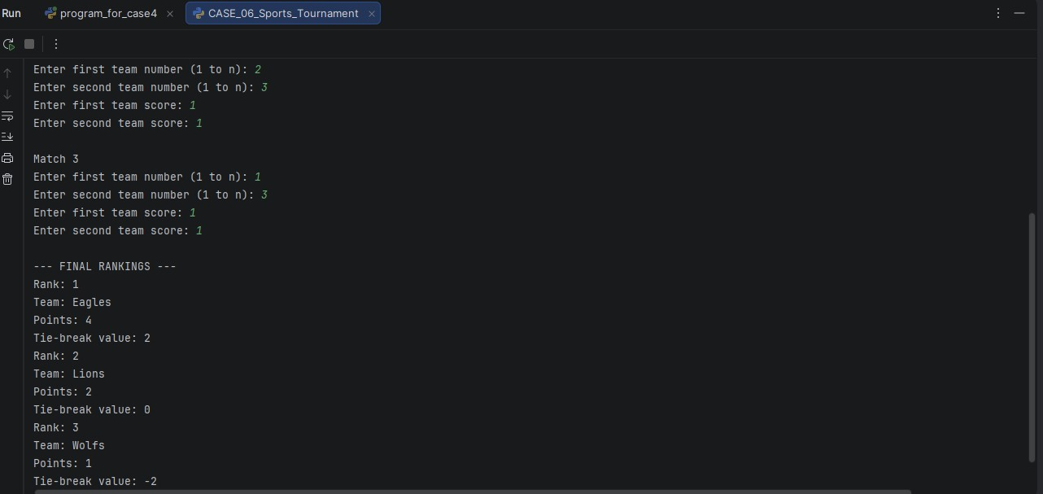
PYTHON ACTIVITY BASED LEARNING
9. Output Screenshot
10. Conclusion
This program awards points from match results, calculates score-based tie-break values, and sorts teams into a final ranking. It provides a consistent way to prepare tournament standings.

Slide 23
PYTHON ACTIVITY BASED LEARNING
CASE 07: University Admission Decision Engine
Problem Statement
Problem Statement
Universities receive applications from many students for different courses. Checking every application manually takes time and may lead to errors. The University Admission Decision Engine automates this process by checking subject eligibility, aggregate marks, and course requirements. It then identifies eligible applicants and generates a ranked list to support admission decisions.
Objectives
Objective
To develop a Python program that evaluates students for university admission based on subject eligibility, aggregate marks, and course-specific minimum marks. The program selects eligible candidates
and ranks them according to their aggregate marks, using a tie-breaking rule when candidates have equal marks.
Assumptions
Assumptions
  Each applicant has a name, subject eligibility status, and aggregate percentage.
  The university offers two courses: CSE and ECE.
  The minimum aggregate percentage is 75% for CSE and 65% for ECE.
  A candidate must meet the subject eligibility requirements for the selected course.
  Candidates with higher aggregate marks receive higher ranks.
  If two candidates have the same aggregate marks, the candidate with higher Mathematics marks gets the higher rank.
  Only eligible candidates are included in the final ranking.
  The program assumes the entered marks and eligibility information are valid.
Algorithm
Algorithm
  Start the program.
  Read the number of applicants.
  For each applicant, enter their name, course, subject eligibility, aggregate percentage, and Mathematics marks.
  Check the minimum aggregate requirement for the selected course.
  If the applicant satisfies both subject eligibility and the aggregate requirement, add them to the eligible list.
  Arrange eligible applicants in descending order of aggregate marks.
  If aggregate marks are equal, rank the applicant with higher Mathematics marks first.
  Display the final ranked list of eligible applicants.
  Stop the program.

Slide 24
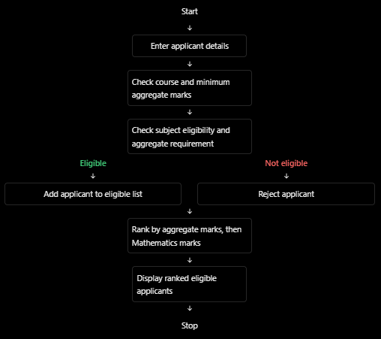
PYTHON ACTIVITY BASED LEARNING
5. Flowchart
Pseudocode
S T A R T
I N P U T n u m b e r o f a p p l i c a n t s C R E A T E a n e m p t y e l i g i b l e l i s t
F O R e a c h a p p l i c a n t : I N P U T n a m e I N P U T c o u r s e
I N P U T s u b j e c t e l i g i b i l i t y I N P U T a g g r e g a t e m a r k s I N P U T M a t h e m a t i c s m a r k s
I F c o u r s e i s C S E :
S E T m i n i m u m m a r k s t o 7 5 E L S E I F c o u r s e i s E C E :
S E T m i n i m u m m a r k s t o 6 5
I F s u b j e c t e l i g i b l e A N D a g g r e g a t e > = m i n i m u m m a r k s : A D D a p p l i c a n t t o e l i g i b l e l i s t
S O R T e l i g i b l e a p p l i c a n t s b y :
  A g g r e g a t e m a r k s i n d e s c e n d i n g o r d e r
  M a t h e m a t i c s m a r k s i n d e s c e n d i n g o r d e r
D I S P L A Y r a n k e d e l i g i b l e a p p l i c a n t s S T O P

Slide 25
PYTHON ACTIVITY BASED LEARNING
Python Source Code / Program
p r i n t ( " U n i v e r s i t y A d m i s s i o n D e c i s i o n E n g i n e " )
e l i g i b l e = [ ]
n = i n t ( i n p u t ( " E n t e r n u m b e r o f a p p l i c a n t s : " ) ) f o r i i n r a n g e ( n ) :
p r i n t ( " \ n A p p l i c a n t " , i + 1 )
n a m e = i n p u t ( " E n t e r n a m e : " )
c o u r s e = i n p u t ( " E n t e r c o u r s e ( C S E / E C E ) : " ) . u p p e r ( ) s u b j e c t = i n p u t ( " S u b j e c t e l i g i b l e ? ( y e s / n o ) : " ) . l o w e r ( ) a g g r e g a t e = f l o a t ( i n p u t ( " E n t e r a g g r e g a t e p e r c e n t a g e : " ) ) m a t h s = f l o a t ( i n p u t ( " E n t e r M a t h e m a t i c s m a r k s : " ) )
i f c o u r s e = = " C S E " : m i n i m u m = 7 5
e l i f c o u r s e = = " E C E " : m i n i m u m = 6 5
e l s e :
p r i n t ( " I n v a l i d c o u r s e ! " ) c o n t i n u e
i f s u b j e c t = = " y e s " a n d a g g r e g a t e > = m i n i m u m : e l i g i b l e . a p p e n d ( [ n a m e , c o u r s e , a g g r e g a t e , m a t h s ] ) p r i n t ( " E l i g i b l e f o r a d m i s s i o n " )
e l s e :
p r i n t ( " N o t e l i g i b l e f o r a d m i s s i o n " )
# S o r t b y a g g r e g a t e m a r k s , t h e n M a t h e m a t i c s m a r k s f o r i i n r a n g e ( l e n ( e l i g i b l e ) ) :
f o r j i n r a n g e ( i + 1 , l e n ( e l i g i b l e ) ) :
i f ( e l i g i b l e [ j ] [ 2 ] > e l i g i b l e [ i ] [ 2 ] o r ( e l i g i b l e [ j ] [ 2 ] = = e l i g i b l e [ i ] [ 2 ] a n d
e l i g i b l e [ j ] [ 3 ] > e l i g i b l e [ i ] [ 3 ] ) ) :
e l i g i b l e [ i ] , e l i g i b l e [ j ] = e l i g i b l e [ j ] , e l i g i b l e [ i ] p r i n t ( " \ n - - - F I N A L A D M I S S I O N R A N K I N G - - - " )
i f l e n ( e l i g i b l e ) = = 0 :
p r i n t ( " N o e l i g i b l e a p p l i c a n t s f o u n d . " ) e l s e :
f o r i i n r a n g e ( l e n ( e l i g i b l e ) ) : p r i n t ( " \ n R a n k : " , i + 1 ) p r i n t ( " N a m e : " , e l i g i b l e [ i ] [ 0 ] )
p r i n t ( " C o u r s e : " , e l i g i b l e [ i ] [ 1 ] ) p r i n t ( " A g g r e g a t e : " , e l i g i b l e [ i ] [ 2 ] ) p r i n t ( " M a t h e m a t i c s m a r k s : " , e l i g i b l e [ i ] [ 3 ] )
Test Cases
Test Cases
Use these test cases to check whether the program works correctly.
| Course | Subject eligible? | Aggregate | Expected result
| CSE | yes
| CSE | yes
| ECE | yes
| ECE |
| CSE |
Test case
| 90% | Eligible
| 70% | Not eligible
| 68% | Eligible
no | 85% | Not eligible
yes | 90% | Eligible; Mathematics marks break the tie

Slide 26
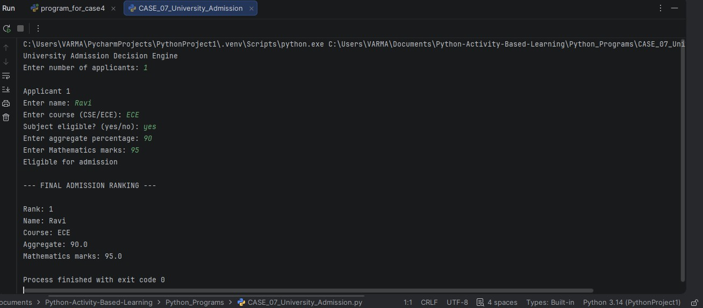
PYTHON ACTIVITY BASED LEARNING
9. Output Screenshot
10. Conclusion
This program checks applicants against course-specific admission requirements and ranks eligible candidates using the stated rules. It supports more consistent screening and tie-breaking.

Slide 27
PYTHON ACTIVITY BASED LEARNING
CASE 08: University Hostel Room Allocation
Problem Statement
Problem Statement
Universities accommodate many students in hostels, and assigning rooms manually can cause confusion, duplicate allocations, and capacity issues. A Hostel Room Allocation System automates the allocation process by checking student eligibility, room capacity, and grouping requirements. It identifies
duplicate assignments and calculates the remaining unallocated student demand, helping hostel administrators manage rooms efficiently.
Objectives
Objectives
To develop a Python program that allocates students to hostel rooms based on room capacity, student eligibility, and grouping constraints. The program also detects duplicate student assignments and calculates the number of students who could not be allocated a room.
Assumptions
Assumptions
  Each student has a unique student ID and a name.
  Each hostel room has a room number, capacity, and eligibility category.
  Students can be assigned only to rooms for which they are eligible.
  A room cannot exceed its maximum capacity.
  Students belonging to the same specified group should be assigned to the same room whenever possible.
  A student cannot be assigned to more than one room.
  If a student cannot be allocated a room, they are counted as unallocated.
  All student details and room capacities are entered correctly.
Algorithm
Algorithm
  Start the program.
  Enter the number of hostel rooms.
  Enter each room's number, capacity, and category.
  Enter the number of students.
  Enter each student's ID, name, category, and group.
  Check whether the student ID has already been entered.
  Find a room with matching eligibility, available capacity, and the required group.
  If a suitable room is found, allocate the student and update the room's occupancy.
  If no suitable room is available, mark the student as unallocated.
  Display room allocations, duplicate assignments, and total unallocated students.
  Stop the program.

Slide 28
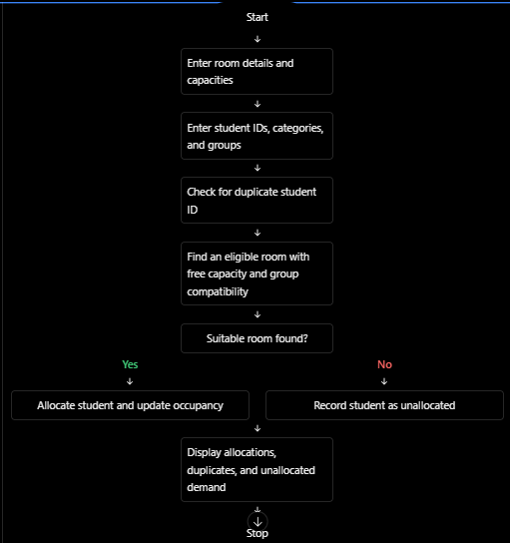
PYTHON ACTIVITY BASED LEARNING
5. Flowchart
6. Pseudocode
S T A R T
I N P U T r o o m d e t a i l s I N P U T s t u d e n t d e t a i l s
C R E A T E e m p t y l i s t s f o r a l l o c a t i o n s a n d d u p l i c a t e s F O R e a c h s t u d e n t :
I F s t u d e n t I D a l r e a d y e x i s t s : R E C O R D d u p l i c a t e a s s i g n m e n t
E L S E :
F I N D a r o o m t h a t :
m a t c h e s s t u d e n t c a t e g o r y h a s a v a i l a b l e c a p a c i t y
s a t i s f i e s g r o u p i n g c o n s t r a i n t s
I F a s u i t a b l e r o o m i s f o u n d : A L L O C A T E s t u d e n t t o t h a t r o o m U P D A T E r o o m o c c u p a n c y
E L S E :
C O U N T s t u d e n t a s u n a l l o c a t e d
D I S P L A Y r o o m a l l o c a t i o n s D I S P L A Y d u p l i c a t e a s s i g n m e n t s
D I S P L A Y t o t a l u n a l l o c a t e d s t u d e n t s
S T O P

Slide 29
PYTHON ACTIVITY BASED LEARNING
7. Python Source Code / Program
p r i n t ( " U n i v e r s i t y H o s t e l R o o m A l l o c a t i o n " )
r o o m s = [ ] a l l o c a t e d = [ ] d u p l i c a t e s = [ ] u n a l l o c a t e d = [ ] s e e n _ i d s = [ ] g r o u p _ r o o m s = { }
n = i n t ( i n p u t ( " E n t e r n u m b e r o f r o o m s : " ) ) f o r i i n r a n g e ( n ) :
p r i n t ( " \ n R o o m " , i + 1 )
n u m b e r = i n p u t ( " E n t e r r o o m n u m b e r : " ) c a p a c i t y = i n t ( i n p u t ( " E n t e r r o o m c a p a c i t y : " ) )
c a t e g o r y = i n p u t ( " E n t e r c a t e g o r y ( B o y s / G i r l s ) : " ) . l o w e r ( )
r o o m s . a p p e n d ( { " n u m b e r " : n u m b e r ,
" c a p a c i t y " : c a p a c i t y , " c a t e g o r y " : c a t e g o r y , " s t u d e n t s " : [ ]
} )
s = i n t ( i n p u t ( " \ n E n t e r n u m b e r o f s t u d e n t s : " ) ) f o r i i n r a n g e ( s ) :
p r i n t ( " \ n S t u d e n t " , i + 1 )
s i d = i n p u t ( " E n t e r s t u d e n t I D : " ) n a m e = i n p u t ( " E n t e r s t u d e n t n a m e : " )
c a t e g o r y = i n p u t ( " E n t e r c a t e g o r y ( B o y s / G i r l s ) : " ) . l o w e r ( ) g r o u p = i n p u t ( " E n t e r g r o u p n a m e : " )
i f s i d i n s e e n _ i d s : p r i n t ( " D u p l i c a t e s t u d e n t I D ! " ) d u p l i c a t e s . a p p e n d ( s i d ) c o n t i n u e
s e e n _ i d s . a p p e n d ( s i d ) a s s i g n e d = F a l s e
f o r r o o m i n r o o m s :
i f g r o u p i n g r o u p _ r o o m s :
i f r o o m [ " n u m b e r " ] ! = g r o u p _ r o o m s [ g r o u p ] : c o n t i n u e
i f ( r o o m [ " c a t e g o r y " ] = = c a t e g o r y a n d l e n ( r o o m [ " s t u d e n t s " ] ) < r o o m [ " c a p a c i t y " ] ) :
r o o m [ " s t u d e n t s " ] . a p p e n d ( n a m e ) a l l o c a t e d . a p p e n d ( n a m e )
i f g r o u p n o t i n g r o u p _ r o o m s : g r o u p _ r o o m s [ g r o u p ] = r o o m [ " n u m b e r " ]
p r i n t ( " A l l o c a t e d t o r o o m : " , r o o m [ " n u m b e r " ] ) a s s i g n e d = T r u e
b r e a k
i f n o t a s s i g n e d :
p r i n t ( " N o s u i t a b l e r o o m a v a i l a b l e . " ) u n a l l o c a t e d . a p p e n d ( n a m e )
p r i n t ( " \ n - - - F I N A L H O S T E L R E P O R T - - - " )
f o r r o o m i n r o o m s :
p r i n t ( " \ n R o o m : " , r o o m [ " n u m b e r " ] ) p r i n t ( " C a t e g o r y : " , r o o m [ " c a t e g o r y " ] ) p r i n t ( " C a p a c i t y : " , r o o m [ " c a p a c i t y " ] ) p r i n t ( " S t u d e n t s : " , r o o m [ " s t u d e n t s " ] ) p r i n t ( " O c c u p i e d : " , l e n ( r o o m [ " s t u d e n t s " ] ) )
p r i n t ( " \ n T o t a l a l l o c a t e d : " , l e n ( a l l o c a t e d ) ) p r i n t ( " D u p l i c a t e I D s : " , d u p l i c a t e s )

Slide 30
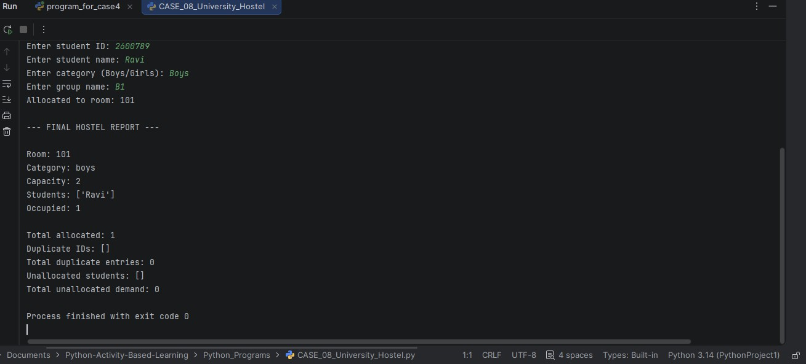
PYTHON ACTIVITY BASED LEARNING
p r i n t ( " T o t a l d u p l i c a t e e n t r i e s : " , l e n ( d u p l i c a t e s ) ) p r i n t ( " U n a l l o c a t e d s t u d e n t s : " , u n a l l o c a t e d ) p r i n t ( " T o t a l u n a l l o c a t e d d e m a n d : " , l e n ( u n a l l o c a t e d ) )
Test Cases
Test Cases
Test case | Input condition | Expected result
  | Eligible student; room has space | Student allocated
  | Room is full | Student unallocated
  | Student category does not match room | Student unallocated
  | Same student ID entered twice | Duplicate detected
  | Group's assigned room is full | Student unallocated
  | No eligible rooms available | All affected students unallocated
9. Output Screenshot
10. Conclusion
This program assigns students to rooms while considering eligibility, room capacity, grouping rules, and duplicate IDs. It also identifies students who could not be allocated a room.

Slide 31
PYTHON ACTIVITY BASED LEARNING
CASE 09: Hackathon Team Formation and Ranking
Problem Statement
Problem Statement
Hackathons involve multiple teams competing across several rounds. Manually forming teams, checking team sizes, calculating round-wise scores, and ranking participants can be time-consuming and may lead to
errors. The Hackathon Team Formation and Ranking System automates these tasks by validating team composition, calculating total scores, and generating a ranked list. When teams have equal total scores, the system uses the final-round score as a tie-breaker.
Objectives
Objectives
To develop a Python program that forms hackathon teams, checks team sizes and student eligibility, calculates total scores across multiple rounds, and ranks teams based on their performance. The program also resolves tied rankings using predefined rules.
Assumptions
Assumptions
  Each student has a unique student ID and name.
  Each team must contain at least 2 and at most 4 students.
  Each student can belong to only one team.
  Every team participates in the same number of hackathon rounds.
  Scores are non-negative numbers.
  The total team score is the sum of scores from all rounds.
  Teams with higher total scores receive higher ranks.
  If two teams have equal total scores, the team with the higher final-round score ranks first.
  If both total and final-round scores are equal, the teams share the same rank.
Algorithm
Algorithm
  Start the program.
  Enter the number of hackathon teams and the number of rounds.
  Enter each team's name and number of members.
  Validate that each team has between 2 and 4 members.
  Enter each member's student ID and name.
  Check that no student ID is assigned to multiple teams.
  Enter each team's score for every round.
  Calculate the total score for each team.
  Sort teams by total score in descending order.
  If total scores are equal, compare final-round scores.
  Assign the same rank to teams whose total and final-round scores are both equal.
  Display the final team rankings and scores.
  Stop the program.

Slide 32
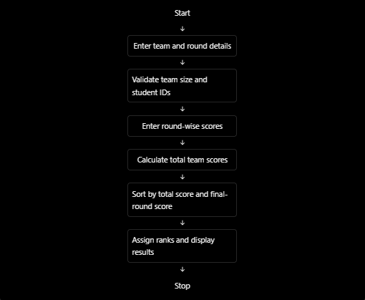
PYTHON ACTIVITY BASED LEARNING
5. Flowchart
Pseudocode
S T A R T
I N P U T n u m b e r o f t e a m s I N P U T n u m b e r o f r o u n d s
C R E A T E a n e m p t y l i s t o f t e a m s C R E A T E a n e m p t y l i s t o f s t u d e n t I D s
F O R e a c h t e a m : I N P U T t e a m n a m e
I N P U T n u m b e r o f m e m b e r s
C H E C K t e a m s i z e i s b e t w e e n 2 a n d 4 I N P U T e a c h s t u d e n t ' s I D a n d n a m e
C H E C K s t u d e n t I D i s n o t a l r e a d y a s s i g n e d
I N P U T s c o r e f o r e a c h r o u n d C A L C U L A T E t o t a l s c o r e
S T O R E t e a m d e t a i l s a n d s c o r e s S O R T t e a m s b y :
  T o t a l s c o r e i n d e s c e n d i n g o r d e r
  F i n a l - r o u n d s c o r e i n d e s c e n d i n g o r d e r
F O R e a c h r a n k e d t e a m :
I F t o t a l s c o r e a n d f i n a l - r o u n d s c o r e e q u a l t h e p r e v i o u s t e a m ' s s c o r e s :
A S S I G N t h e s a m e r a n k E L S E :
A S S I G N t h e c u r r e n t p o s i t i o n a s r a n k
D I S P L A Y t e a m n a m e s , s c o r e s , a n d r a n k s S T O P

Slide 33
PYTHON ACTIVITY BASED LEARNING
7. Python Source Code / Program
p r i n t ( " H a c k a t h o n T e a m F o r m a t i o n a n d R a n k i n g " )
t e a m s = [ ]
n = i n t ( i n p u t ( " E n t e r n u m b e r o f t e a m s : " ) ) r o u n d s = i n t ( i n p u t ( " E n t e r n u m b e r o f r o u n d s : " ) )
f o r i i n r a n g e ( n ) : p r i n t ( " \ n T e a m " , i + 1 )
n a m e = i n p u t ( " E n t e r t e a m n a m e : " )
s i z e = i n t ( i n p u t ( " E n t e r n u m b e r o f m e m b e r s ( 2 t o 4 ) : " ) ) w h i l e s i z e < 2 o r s i z e > 4 :
p r i n t ( " T e a m m u s t h a v e 2 t o 4 m e m b e r s . " )
s i z e = i n t ( i n p u t ( " E n t e r n u m b e r o f m e m b e r s : " ) )
m e m b e r s = [ ]
f o r j i n r a n g e ( s i z e ) :
s t u d e n t _ i d = i n p u t ( " E n t e r s t u d e n t I D : " )
w h i l e a n y ( s t u d e n t _ i d i n t e a m [ " i d s " ] f o r t e a m i n t e a m s ) o r s t u d e n t _ i d i n m e m b e r s : p r i n t ( " D u p l i c a t e s t u d e n t I D ! E n t e r a n o t h e r I D . " )
s t u d e n t _ i d = i n p u t ( " E n t e r s t u d e n t I D : " )
m e m b e r s . a p p e n d ( s t u d e n t _ i d ) t o t a l = 0
l a s t _ s c o r e = 0
f o r r i n r a n g e ( r o u n d s ) :
s c o r e = i n t ( i n p u t ( " E n t e r s c o r e f o r r o u n d " + s t r ( r + 1 ) + " : " ) ) w h i l e s c o r e < 0 :
p r i n t ( " S c o r e c a n n o t b e n e g a t i v e . " )
s c o r e = i n t ( i n p u t ( " E n t e r s c o r e a g a i n : " ) ) t o t a l + = s c o r e
l a s t _ s c o r e = s c o r e
t e a m s . a p p e n d ( { " n a m e " : n a m e , " i d s " : m e m b e r s , " t o t a l " : t o t a l , " l a s t " : l a s t _ s c o r e
} )
t e a m s . s o r t ( k e y = l a m b d a x : ( x [ " t o t a l " ] , x [ " l a s t " ] ) , r e v e r s e = T r u e ) p r i n t ( " \ n - - - F I N A L R A N K I N G S - - - " )
f o r i i n r a n g e ( n ) :
i f i > 0 a n d t e a m s [ i ] [ " t o t a l " ] = = t e a m s [ i - 1 ] [ " t o t a l " ] a n d t e a m s [ i ] [ " l a s t " ] = = t e a m s [ i - 1 ] [ " l a s t " ] :
r a n k = t e a m s [ i - 1 ] [ " r a n k " ] e l s e :
r a n k = i + 1
t e a m s [ i ] [ " r a n k " ] = r a n k
p r i n t ( " R a n k : " , r a n k , " | T e a m : " , t e a m s [ i ] [ " n a m e " ] , " | T o t a l S c o r e : " , t e a m s [ i ] [ " t o t a l " ] )

Slide 34
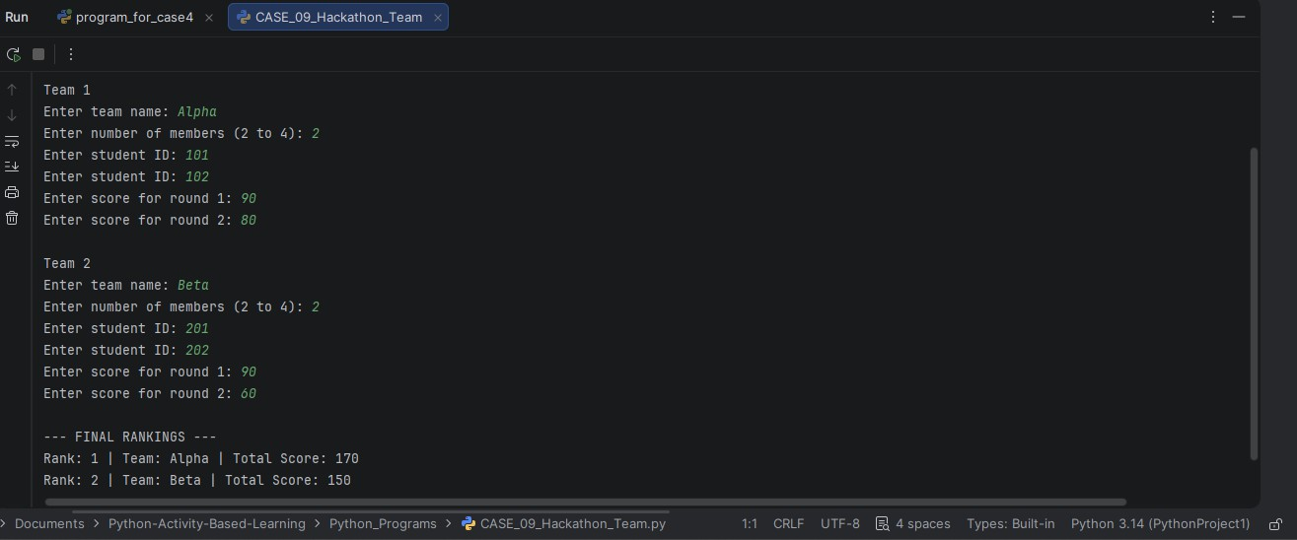
PYTHON ACTIVITY BASED LEARNING
8. Test Cases
.Test Cases
Test case | Input condition
1 | accepted
2 |
Team has 3 members |
| Expected result
Team size
for a valid size
Team has 5 members |
Program asks
3 | | Same student ID entered for two teams | | | Duplicate ID detected
4 | | Team has a negative score | |  | Program asks
for a valid score
5 | | One team has a higher total score | |  |  | That team ranks higher
6 | | Total scores equal, final-round scores differ |  | | | Higher final-round
score ranks higher
7 | Total and final-round scores both equal rank
| Teams share the same
9. Output Screenshot
10. Conclusion
This program validates hackathon team composition and student IDs, totals scores across rounds, and ranks teams using the specified tie-break rules. It supports fairer and more organized team evaluation.

Slide 35
PYTHON ACTIVITY BASED LEARNING
CASE 10: University Scholarship Allocation
Problem Statement
Problem Statement
Universities receive scholarship applications from many students. Manually checking marks, attendance, and family income can be time-consuming and may cause errors. The University Scholarship Allocation System automates the evaluation process by checking eligibility criteria, preparing a ranked list of eligible applicants, and resolving ties fairly. This helps universities allocate scholarships in an
organized and transparent manner.
Objectives
Objectives
To develop a Python program that evaluates scholarship applicants based on aggregate marks, subject-wise minimum marks, attendance percentage, and family income. The system identifies eligible students, ranks them according to their academic performance, and resolves ties using predefined rules.
Assumptions
Assumptions
  Each applicant has a unique student ID and name.
  The minimum aggregate marks required are 75%.
  Each subject must have at least 60 marks out of 100.
  The minimum attendance requirement is 75%.
  The maximum annual family income allowed is ₹2,50,000.
  Applicants must satisfy all four eligibility conditions to qualify.
  Eligible applicants are ranked by aggregate marks in descending order.
  If aggregate marks are equal, higher attendance receives the higher rank.
  If both aggregate marks and attendance are equal, the applicant with lower family income receives the higher rank.
  The program uses these assumed criteria for educational purposes; actual scholarship rules may differ.
Algorithm
Algorithm
  Start the program.
  Enter the number of scholarship applicants.
  For each applicant, enter their student ID, name, aggregate percentage, subject marks, attendance percentage, and annual family income.
  Check whether the aggregate marks are at least 75%.
  Check whether every subject mark is at least 60.
  Check whether attendance is at least 75%.
  Check whether annual family income is ₹2,50,000 or less.
  Add applicants who satisfy all conditions to the eligible list.
  Sort eligible applicants by aggregate marks, attendance, and family income.
  Assign ranks according to the predefined tie-breaking rules.
  Display the eligible applicants, their ranks, and the total number of eligible students.
  Stop the program.

Slide 36
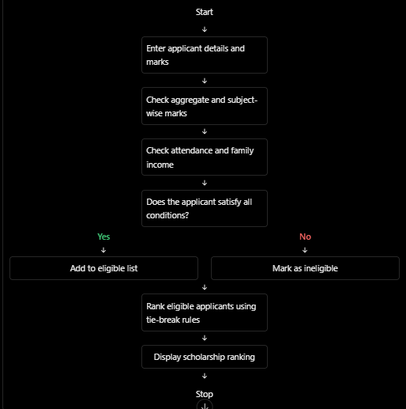
PYTHON ACTIVITY BASED LEARNING
5. Flowchart
Pseudocode
S T A R T
I N P U T n u m b e r o f a p p l i c a n t s C R E A T E a n e m p t y e l i g i b l e l i s t F O R e a c h a p p l i c a n t :
I N P U T s t u d e n t I D a n d n a m e I N P U T a g g r e g a t e p e r c e n t a g e I N P U T m a r k s o f e a c h s u b j e c t I N P U T a t t e n d a n c e p e r c e n t a g e I N P U T a n n u a l f a m i l y i n c o m e
I F a g g r e g a t e > = 7 5
A N D e v e r y s u b j e c t m a r k > = 6 0 A N D a t t e n d a n c e > = 7 5
A N D i n c o m e < = 2 5 0 0 0 0 :
A D D a p p l i c a n t t o e l i g i b l e l i s t
E L S E :
M A R K a p p l i c a n t a s i n e l i g i b l e
S O R T e l i g i b l e a p p l i c a n t s b y :
  A g g r e g a t e m a r k s ( h i g h e s t f i r s t )
  A t t e n d a n c e ( h i g h e s t f i r s t )
  F a m i l y i n c o m e ( l o w e s t f i r s t )
A S S I G N r a n k s u s i n g t h e t i e - b r e a k i n g r u l e s D I S P L A Y e l i g i b l e a p p l i c a n t s a n d r a n k s S T O P

Slide 37
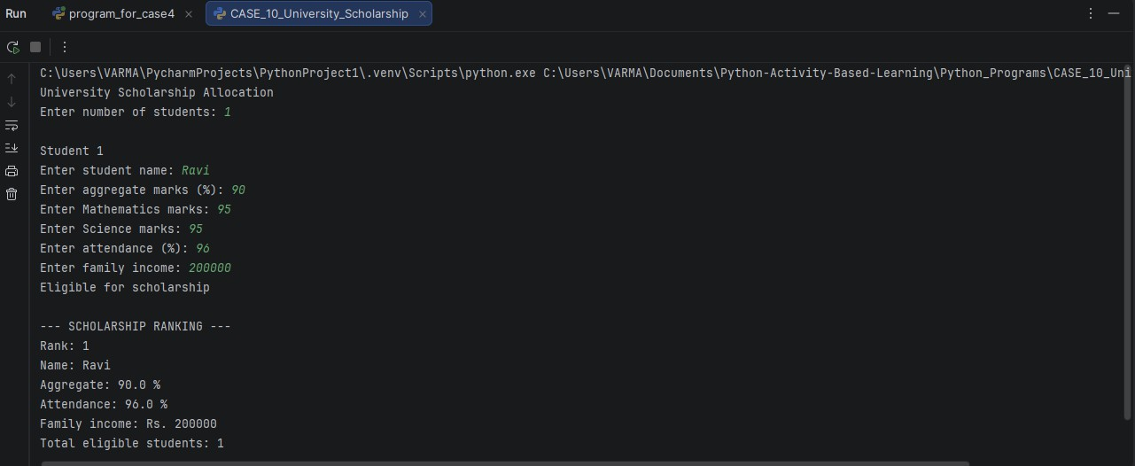
PYTHON ACTIVITY BASED LEARNING
Python Source Code / Program
p r i n t ( " U n i v e r s i t y S c h o l a r s h i p A l l o c a t i o n " )
s t u d e n t s = [ ]
n = i n t ( i n p u t ( " E n t e r n u m b e r o f s t u d e n t s : " ) ) f o r i i n r a n g e ( n ) :
p r i n t ( " \ n S t u d e n t " , i + 1 )
n a m e = i n p u t ( " E n t e r s t u d e n t n a m e : " )
a g g r e g a t e = f l o a t ( i n p u t ( " E n t e r a g g r e g a t e m a r k s ( % ) : " ) ) m a t h s = i n t ( i n p u t ( " E n t e r M a t h e m a t i c s m a r k s : " ) ) s c i e n c e = i n t ( i n p u t ( " E n t e r S c i e n c e m a r k s : " ) ) a t t e n d a n c e = f l o a t ( i n p u t ( " E n t e r a t t e n d a n c e ( % ) : " ) ) i n c o m e = i n t ( i n p u t ( " E n t e r f a m i l y i n c o m e : " ) )
i f ( a g g r e g a t e > = 7 5 a n d m a t h s > = 6 0
a n d s c i e n c e > = 6 0 a n d a t t e n d a n c e > = 7 5 a n d i n c o m e < = 2 5 0 0 0 0 ) :
p r i n t ( " E l i g i b l e f o r s c h o l a r s h i p " ) s t u d e n t s . a p p e n d ( [ n a m e , a g g r e g a t e , a t t e n d a n c e , i n c o m e ] )
e l s e :
p r i n t ( " N o t e l i g i b l e " )
# R a n k s t u d e n t s
s t u d e n t s . s o r t ( k e y = l a m b d a x : ( - x [ 1 ] , - x [ 2 ] , x [ 3 ] ) )
p r i n t ( " \ n - - - S C H O L A R S H I P R A N K I N G - - - " )
f o r i i n r a n g e ( l e n ( s t u d e n t s ) ) : p r i n t ( " R a n k : " , i + 1 ) p r i n t ( " N a m e : " , s t u d e n t s [ i ] [ 0 ] )
p r i n t ( " A g g r e g a t e : " , s t u d e n t s [ i ] [ 1 ] , " % " )
p r i n t ( " A t t e n d a n c e : " , s t u d e n t s [ i ] [ 2 ] , " % " ) p r i n t ( " F a m i l y i n c o m e : R s . " , s t u d e n t s [ i ] [ 3 ] )
p r i n t ( " T o t a l e l i g i b l e s t u d e n t s : " , l e n ( s t u d e n t s ) )
Test Cases
Test Cases
Test case | Input condition | Expected result
  | All eligibility conditions satisfied | Eligible
  | Aggregate below 75% | Ineligible
  | Any subject mark below 60 | Ineligible
  | Attendance below 75% | Ineligible
  | Family income above ₹2,50,000 | Ineligible
  | Equal aggregate, different attendance | Higher attendance ranks first
  | Equal aggregate and attendance | Lower family income ranks first
9. Output Screenshot

Slide 38
PYTHON ACTIVITY BASED LEARNING
10. Conclusion
This program checks scholarship applicants against academic, attendance, and income conditions, then ranks eligible students using the stated criteria. It makes the evaluation process more systematic and transparent.

